Slide 1
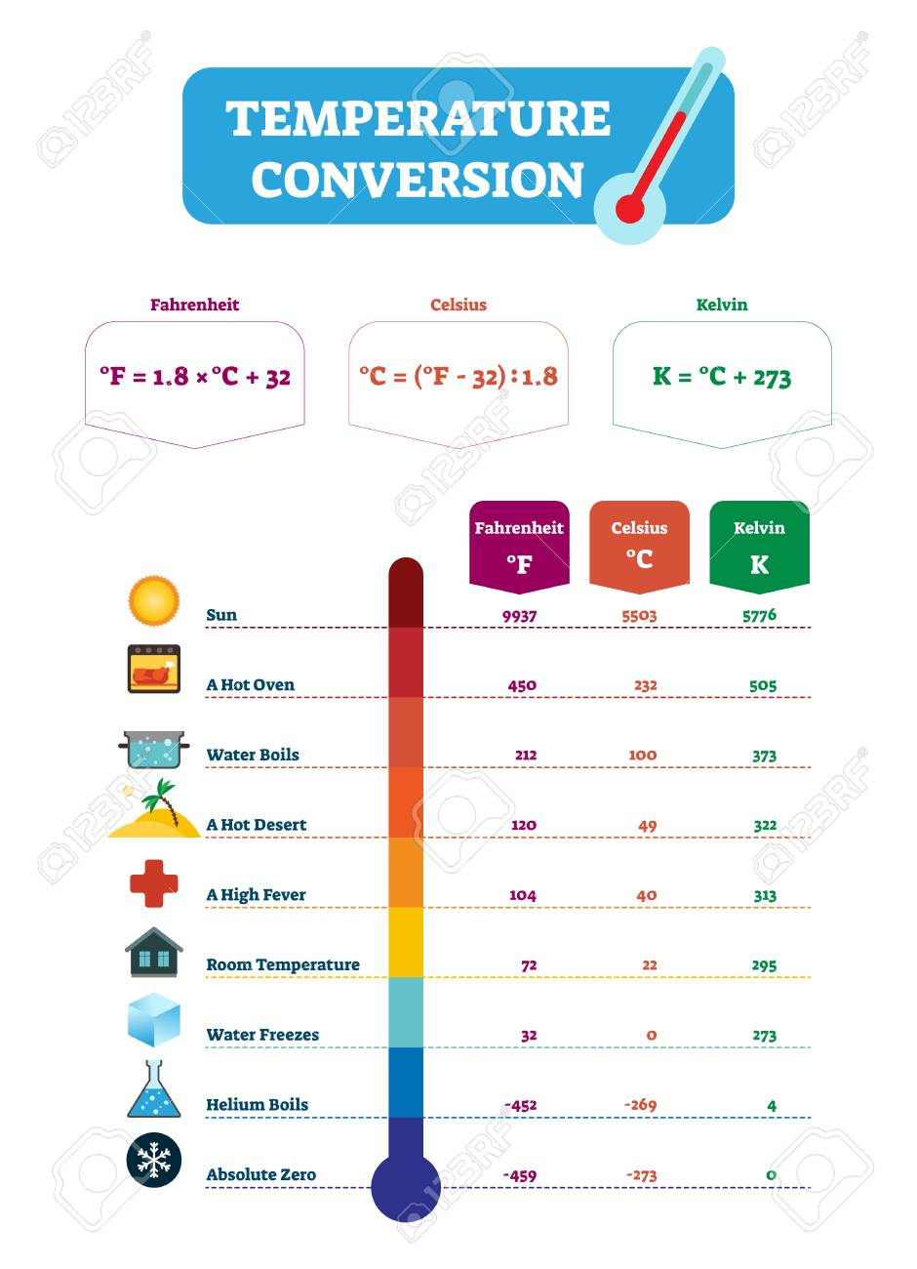
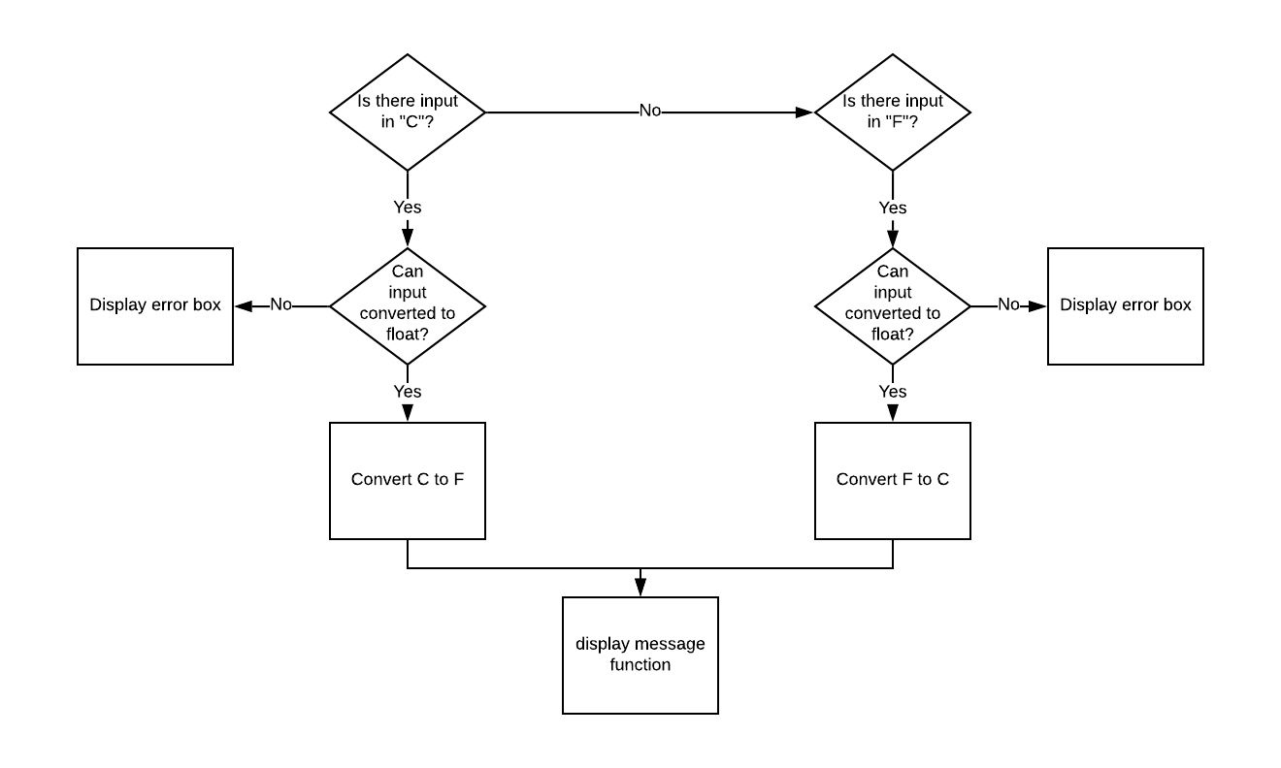
Temperature Converter
Developer: Kihyup Yoon
Description: Temperature converter will allow users to convert Celsius to Fahrenheit and Fahrenheit to Celsius easily
Github URL: https://github.com/ksu-is/Temp-Converter/

